Slide 1
HOUSE PRICE PREDICTION
BY: ARPITA MISHRA

Slide 2
Introduction
Housing and real estate market is one of the major contributors in the world’s economy.
Data Science is being utilized by the companies to increase their overall revenue, profits, improving their marketing strategies and focusing on changing trends in house sales and purchases.
The present project is associated with a US-based housing company named Surprise Housing which is planning to enter the Australian market.
The company uses data analytics to purchase houses at a price below their actual values and flip them at a higher price. The company is looking at prospective properties to buy houses to enter the market.
We are trying to build a model using Machine Learning in order to predict the actual value of the prospective properties and decide whether to invest in them or not.

Slide 3
Data set Information
Two datasets were given to us as train and test data in csv format.
Train data set was used to train the model while test data set was used for house price prediction with the model built.
Train data was found to have 81 columns and 1168 rows while test data set had 80 columns and 292 rows.
The dataset had both categorical as well as numerical columns.
The dataset had null values in few of the columns.
The entire project was performed on jupyter notebook.

Slide 4
Data loading and Preprocessing
All the necessary libraries like Pandas, numpy and matplot lib were imported.
The data set were retrieved as train_data and test_data by using pd.read_csv.
Both the train and test data were analysed for null values.
train_data.isnull().sum()
test_data.isnull().sum()
There were five features (PoolQC, MiscFeature, Alley, Fence, FireplaceQu) with more than 45-50 percent null values. These features were dropped from both the data set.
train_data.drop(['PoolQC','MiscFeature','Alley','Fence','FireplaceQu'],axis=1, inplace=True)
test_data.drop(['PoolQC','MiscFeature','Alley','Fence','FireplaceQu'],axis=1, inplace=True)
Null values in features with continuous values were replaced by median/mean of that column.
train_data['MasVnrArea']=train_data['MasVnrArea'].fillna(train_data['MasVnrArea'].median())
train_data['GarageYrBlt']=train_data['GarageYrBlt'].replace(np.nan,0)
train_data['LotFrontage']=train_data['LotFrontage'].fillna(train_data['LotFrontage'].mean())

Slide 5
Null values in the categorical columns were replaced by mode of the respective column.
train_data['MasVnrType']=train_data['MasVnrType'].fillna(train_data['MasVnrType'].mode()[0])
train_data['BsmtQual']=train_data['BsmtQual'].fillna(train_data['BsmtQual'].mode()[0])
train_data['BsmtCond']=train_data['BsmtCond'].fillna(train_data['BsmtCond'].mode()[0])
train_data['BsmtFinType1']=train_data['BsmtFinType1'].fillna(train_data['BsmtFinType1'].mode()[0])
train_data['BsmtFinType2']=train_data['BsmtFinType2'].fillna(train_data['BsmtFinType2'].mode()[0])
train_data['BsmtExposure']=train_data['BsmtExposure'].fillna(train_data['BsmtExposure'].mode()[0])
train_data['GarageCond']=train_data['GarageCond'].fillna(train_data['GarageCond'].mode()[0])
train_data['GarageQual']=train_data['GarageQual'].fillna(train_data['GarageQual'].mode()[0])
train_data['GarageFinish']=train_data['GarageFinish'].fillna(train_data['GarageFinish'].mode()[0])
train_data['GarageType']=train_data['GarageType'].fillna(train_data['GarageType'].mode()[0])
Categorical and Numerical Columns with nan values of test dataset were similarly treated.

Slide 6
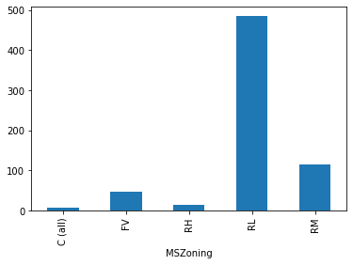
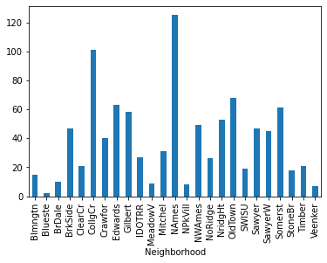
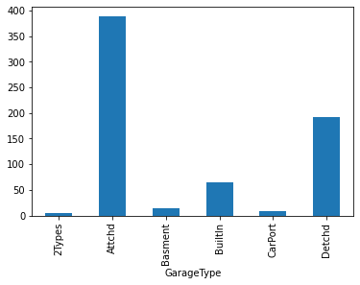
Graphical representation of Categorical features Vs House Price
train_data.groupby(‘features')['SalePrice'].nunique().plot(kind='bar')
plt.show()
Houses in the category of Residential low density had a higher price range as compared to other categories.
Houses near north Ames region had a higher price.
Houses with attached garage had higher price as compared to detached one.

Slide 7
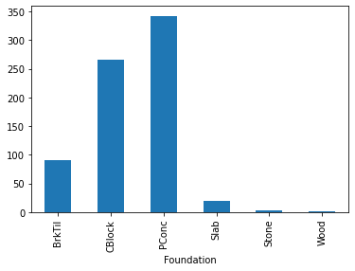
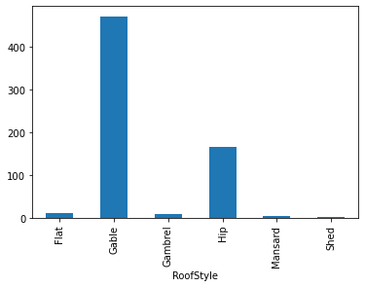
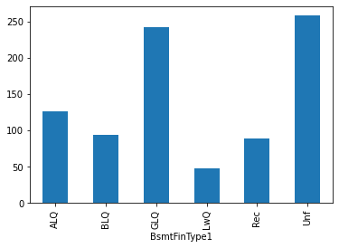
Houses which had the concrete foundation had the highest price while the one with wooden foundation had the least price.
Houses with Gable type of roof were more expensive.

Slide 8
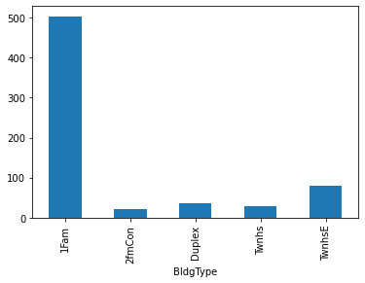
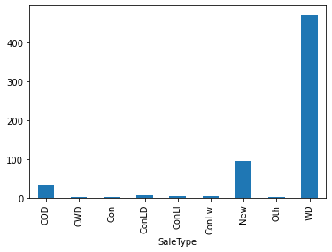
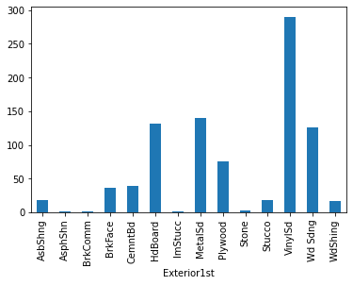
1Family houses had more price as compared to duplex and other types of houses.
Vinyl sided exterior has higher price.

Slide 9
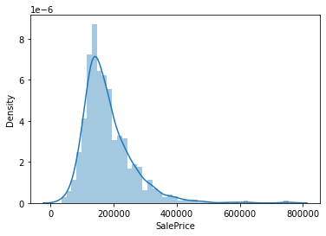
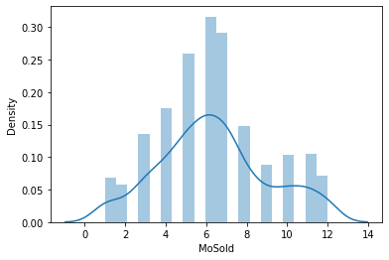
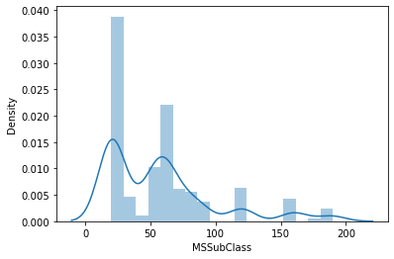
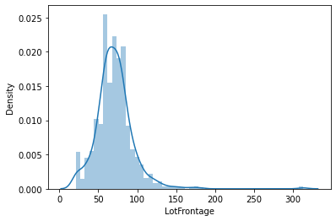
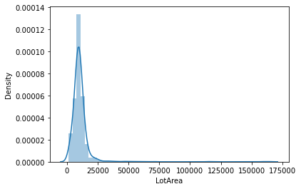
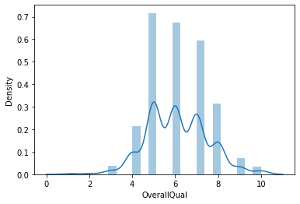
Dist Plot of Numerical Features

Slide 10
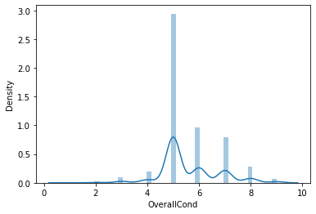
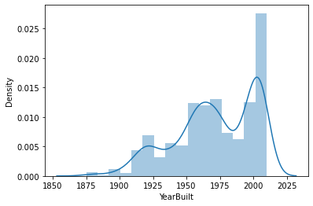
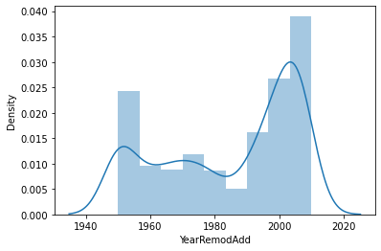
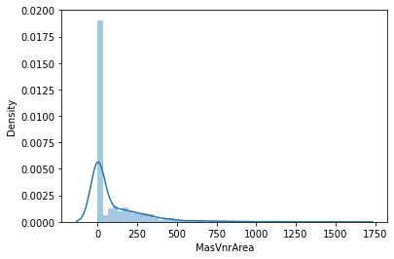
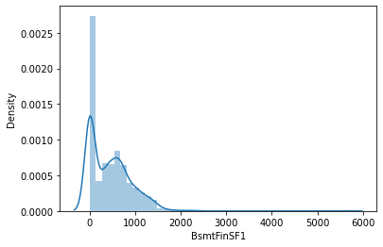
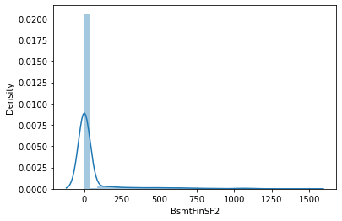

Slide 11
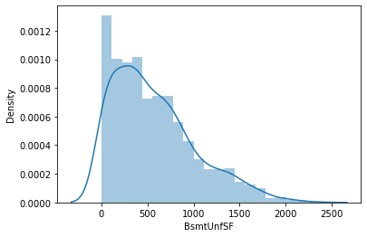
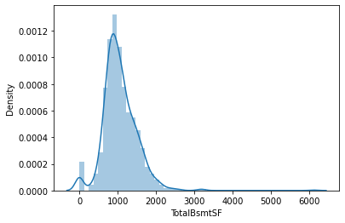
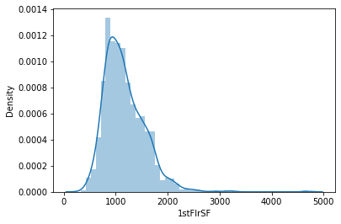
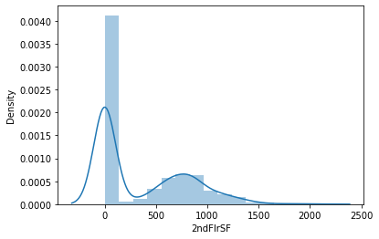
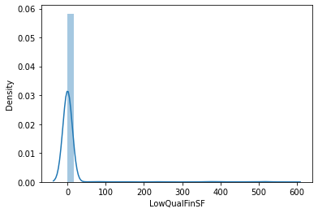
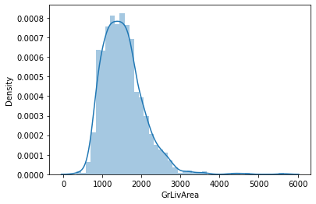

Slide 12
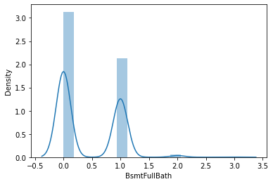
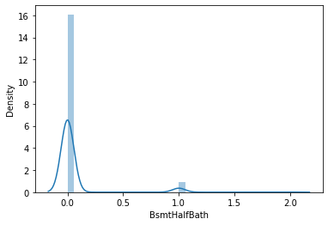
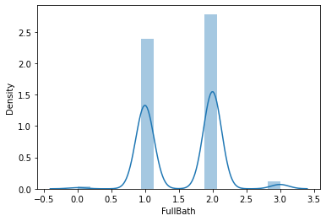
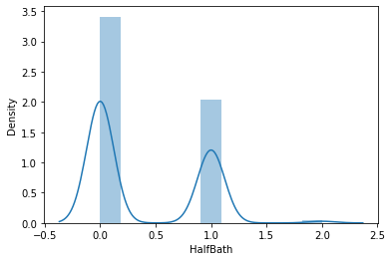
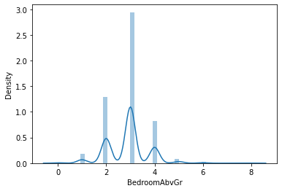
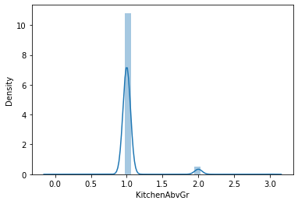

Slide 13
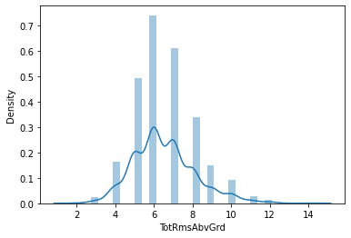
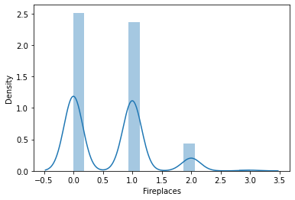
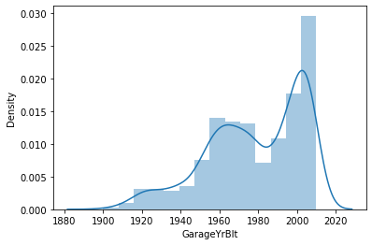
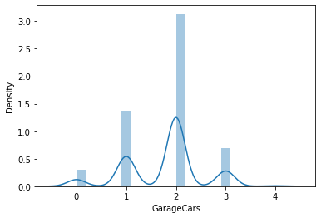
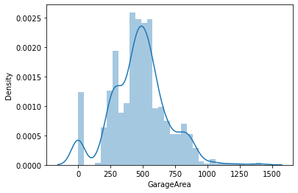
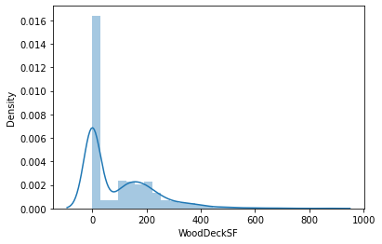
Few columns like-'OverallQual', 'OverallCond', 'GarageCars','MonthSold', 'yearSold','KitchenAbvGr', 'HalfBath', 'Fullbath', 'BsmthalfBath',had discrete values which was evident from the bars.Also there was skewness in few of the columns like BsmtUnfSF, WoodDeckSF,OpenPorchSF.

Slide 14
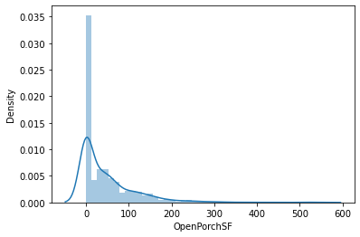
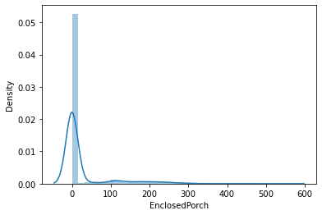
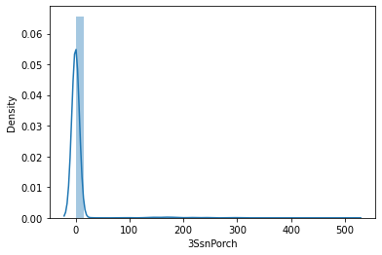
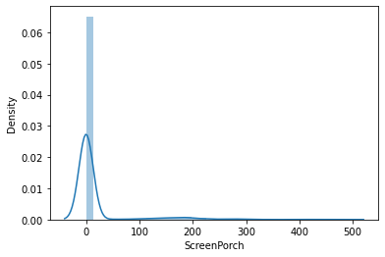
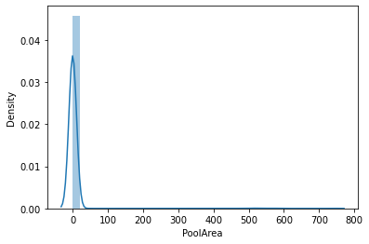
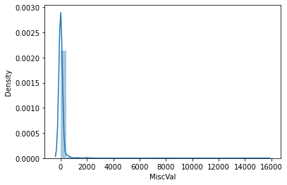
Most of the houses were of average quality and the basement area of 1000 sqft.It was Strange to know that most of the houses were sold in the month of June-july and majority of the houses did not have enclosedporch included to it.

Slide 15
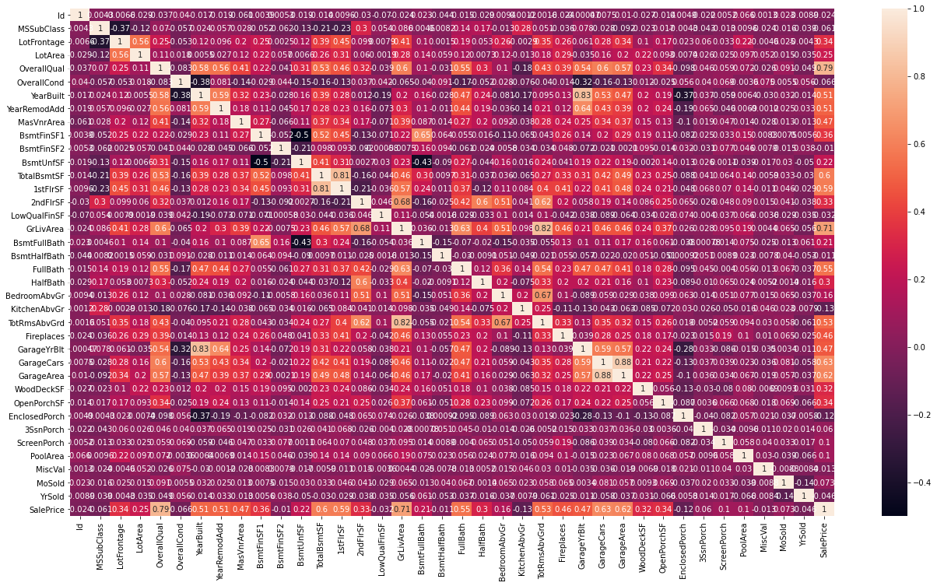
In [341]:
Finding correlation among numerical data
House price was found to be positively correlated to the Overall Quality,Total area of house in square feet, number of bathrooms, Garage Area, Ground floor living area, Total rooms above ground and woodDeck area.

Slide 16
Transforming Categorical features into numerical
Ordinal Encoding
All the categorical column with ordinal data were transformed into numerical by ordinal encoder
from sklearn.preprocessing import OrdinalEncoder
list1=['LotShape', 'LandContour', 'LandSlope', 'ExterQual', 'ExterCond','BsmtQual', 'BsmtCond', 'BsmtExposure', 'BsmtFinType1', 'BsmtFinType2', 'HeatingQC', 'KitchenQual', 'GarageFinish', 'GarageQual', 'GarageCond','PavedDrive’]
oe=OrdinalEncoder()
for i in list1:
train_data[i]=oe.fit_transform(train_data[i].values.reshape(-1,1))
One hot encoding of training dataset
All the categorical column with ordinal data were transformed into numerical by ordinal encoder
train_data1=pd.get_dummies(train_data).copy()
Splitting of Data into X and Y
x=train_data1.drop('SalePrice', axis=1)
y=train_data1['SalePrice’]

Slide 17
Standarisation
from sklearn.preprocessing import StandardScaler
scaler=StandardScaler()
ScaledX=scaler.fit_transform(x)
PCA
One hot encoding led to an increase in columns from 80 to 210 columns .Thus, PCA will be performed to reduce the number of features.
from sklearn.decomposition import PCA
testpca=PCA()
New_x=testpca.fit(ScaledX)
New_x.explained_variance_ratio_
var_cumu=np.cumsum(New_x.explained_variance_ratio_)*100
k=np.argmax(var_cumu>90)
FinalPCA=PCA(n_components=k)
FinalData=FinalPCA.fit_transform(ScaledX)
FinalData=pd.DataFrame(FinalData)

Slide 18
To align the number of columns in test and train data set
Since the number of columns were different in train and test dataset after one hot encoding, we used align method
final_train,final_test=FinalData.align(ScaledTest,join='inner',axis=1)
ModelBuilding
Now train tst split will be done from the training dataset and the testing dataset is kept separate for validation
x_train,x_test,y_train,y_test=train_test_split(FinalData,y,test_size=0.30,random_state=1)
final_train.shape
final_test.shape

Slide 19
Linear Regression
lnr=LinearRegression()
lnr.fit(x_train,y_train)
lnr.coef_
lnr.score(x_train,y_train)
0.89
predlnr=lnr.predict(x_test)
print('mae_lnr',mean_absolute_error(y_test,predlnr))
print('mse_lnr',mean_squared_error(y_test,predlnr))
print('r2 score_lnr',r2_score(y_test,predlnr))
mae_lnr=19222.0
mse_lnr=753470267
The r2 score of linearRegressor was found 85 percent.

Slide 20
Random Forest Regressor
rfr=RandomForestRegressor()
rfr.fit(x_train,y_train)
rfr.score(x_train,y_train)
0.97
predrfr=rfr.predict(x_test)
print('mae_rfr',mean_absolute_error(y_test,predrfr))
print('mse_rfr',mean_squared_error(y_test,predrfr))
print('r2 score_rfr',r2_score(y_test,predrfr))
mae_rfr=18099
mse_rfr=662265579
The r2 score of Random Forest was 86.9 percent

Slide 21
Cross Validation
Cross Val score was determined by importing cross_val_score from sklearn
from sklearn.model_selection import cross_val_score
print ("cross val score for linear regression is:",cross_val_score(lnr,FinalData,y,scoring='r2',cv=3).mean())
print ("cross val score for random forest regressor is:",cross_val_score(rfr,FinalData,y,scoring='r2',cv=3).mean())
The cross val score was found to be 0.76 and0.81 respectively for lnr and rfr
There was less difference in r2 score and crossval score in Random Forest Regressor.So we will proceed with Hyperparameter tuning of RFR
HyperParameter Tuning was performed with the help of Randomized CV and best parameter were obtained.
Finally, Random Forest model was built with best parameter and checked.
final_model=RandomForestRegressor(n_estimators=200,min_samples_split=2,min_samples_leaf=2,max_features='auto’)
final_model.fit(x_train,y_train)
final_model.score(x_train,y_train)
predfinal=final_model.predict(x_test)
R2 score was finally found to be 0.87 ie 87 percent

Slide 22
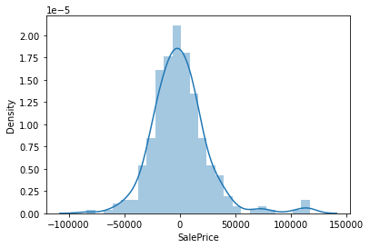
Dist-Plot to see the distribution of Sale Price
sb.distplot(y_test-predfinal)
plt.show()
Saving the model
import joblib
filename='finalhousepricemodel.pkl'
joblib.dump(final_model,'finalhousepricemodel.pkl')

Slide 23
Predicting the house price of the test dataset by the final model
#predicting the house price of the test data set...
test_pred= final_model.predict(final_test)
The predicted house Sale price were observed
print(test_pred)
Summary and Conclusion
Thus, with the present model we were able to predict the price of houses in the test data set with the available independent variables.
This model will then be used by the management to understand how exactly the prices vary with the variables.
They can accordingly manipulate the strategy of the firm and concentrate on areas that will yield high returns. Further, the model will be a good way for the management to understand the pricing dynamics of a new market.

